Slide 1


Green Pace
Security Policy Presentation
Developer: Donald Thibodeaux

Slide 2

OVERVIEW: DEFENSE IN DEPTH
This policy defines the core security principals , C/C++ coding standards; authorization, authentication, and auditing standards; and data encryption standards.

Slide 3
THREATS MATRIX
Likely Likely has a 61-90 percent chance of occurring. This risk level needs regular attention, they are bound to reoccur therefore require a consistent mitigation strategy | Priority Priority means the defect must be resolved as soon as possible, it affects the system severely and cannot be used until it is fixed.
Low priority Low priority means the defect is an irritant, but repair can be done once the more serious defect has been fixed. | Unlikely This risk has a low chance of occurring 11 to 40 percent. It is a good idea keep an eye out.

Slide 4
10 PRINCIPLES
1. Validate Input Data
Coding standard: Use input validation techniques to ensure the input data is of the expected format, length and range.
2. Heed Compiler Warnings
Coding standard: Enable compiler warnings and treat them as errors to catch potential bugs or issues early on.
3. Architect and Design for Security Policies
Coding standard: Identify security requirements and policies early in the design phase to ensure they are integrated into the system architecture.
4. Keep It Simple
Coding standard: Avoid unnecessary complexity or abstraction that can make code difficult to understand or modify.
5. Default Deny
Coding standard: Use whitelisting techniques to allow access only to authorized users, applications, or services.
6. Adhere to the Principle of Least Privilege
Coding standard: Assign the minimum necessary privileges to users, applications, or services to perform their tasks.
7. Sanitize Data Sent to Other Systems
Coding standard: Implement encryption techniques to protect sensitive data and prevent unauthorized access or disclosure.
8. Practice Defense in Depth
Coding standard: Implement multiple layers of security controls, such as firewalls, intrusion detection systems (IDS), and access controls, to provide overlapping protection against security threats.
9. Use Effective Quality Assurance Techniques
Coding standard: Use automated testing tools to identify and correct defects in code.
10. Adopt a Secure Coding Standard
Coding standard: Regularly review and update the coding standard to ensure that it reflects the latest security requirements and best practices.
Notes:
Coding principles, refer to a set of best practices and guidelines that programmers follow when writing code
The 10 principles that green pace follows are

Slide 5
CODING STANDARDS
Ranking system is based on three factors. The impact of the vulnerability, the likelihood of the vulnerability being exploited, and the difficulty of detecting and fixing the vulnerability.
Rule | Severity | Likelihood | Remediation Cost | Priority
STD-001-CPP | Low | Unlikely | Low | High
STD-002-C | High | Likely | High | Medium
STD-003-CPP | High | Likely | Medium | High
STD-004-C | High | Unlikely | High | Low
STD-005-CPP | High | Likely | Medium | High
STD-006-C | Low | Unlikely | High | Low
STD-007-CPP | Low | Probable | Medium | Low
STD-008-C | Low | Unlikely | Low | Low
STD-009-C | Low | Unlikely | Low | Low
STD-010-CPP | High | Likely | High | Medium

Slide 6
ENCRYPTION POLICIES
Encryption in rest | Encryption at flight | Encryption in use
Encryption at rest is encryption that is used to help protect data that is stored on a disk or backup media. Encryption at rest is designed to prevent the attacker from accessing the unencrypted data by ensuring the data is encrypted when on disk. The same key encrypts and decrypts data. | Encryption at flight means that you encrypt data when it’s being transmitted. Data that goes over internal network or the internet is vulnerable. Each packet sent in a session is encrypted independently. Transport encryption uses two symmetric 128-bit AES session keys, randomly generated at session initiation. Dual-key encryption and decryption allows packet-by-packet verification at the remote end, and non-conforming packets are discarded (Vince Lo Faso, 2015). | Encryption in use is the process of encrypting data while it is being used. This ensures sensitive data is never left unsecured. All sensitive data is encrypted, data is encrypted throughout the entire data life, access to unencrypted data is controlled, Governance is provided through a centralized, simple platform, Anomalies are detected and responded to in real time.
Notes:
Encryption is the process of converting plaintext into ciphertext using a cryptographic algorithm and a key. The purpose of encryption is to protect data from unauthorized access or disclosure, by making it unreadable to anyone who does not have the key to decrypt it. I will explain encryption in rest, encryption in flight and encryption in use

Slide 7
TRIPLE-A POLICIES
Authentication | Authorization | Accounting
Authentication identifies the user to ensure the right user is being granted access. This is normally done with username and password. If the username and the password match what is stored the user is granted access. | Authorization is the process that determines whether the user has authority to issue certain commands or certain resources. Users should only have access to the resources needed to fulfill their task. Access should be denied once that resource is no longer needed, or task is complete. This also ensures someone without the proper authorization can not modify systems or databases. | Accounting is a tool utilized to account for user behavior. Accounting can be used to find what resources were accessed and what activities were done on the users account. Accounting is carried out by logging session statistics and usage information and is used for authorization control, billing, trend analysis, resource utilization, and capacity planning activities.
Notes:
TRIPLE-A POLICIES
This is made up of authentication, authorization and Accounting.

Slide 8
Unit Testing

Slide 9
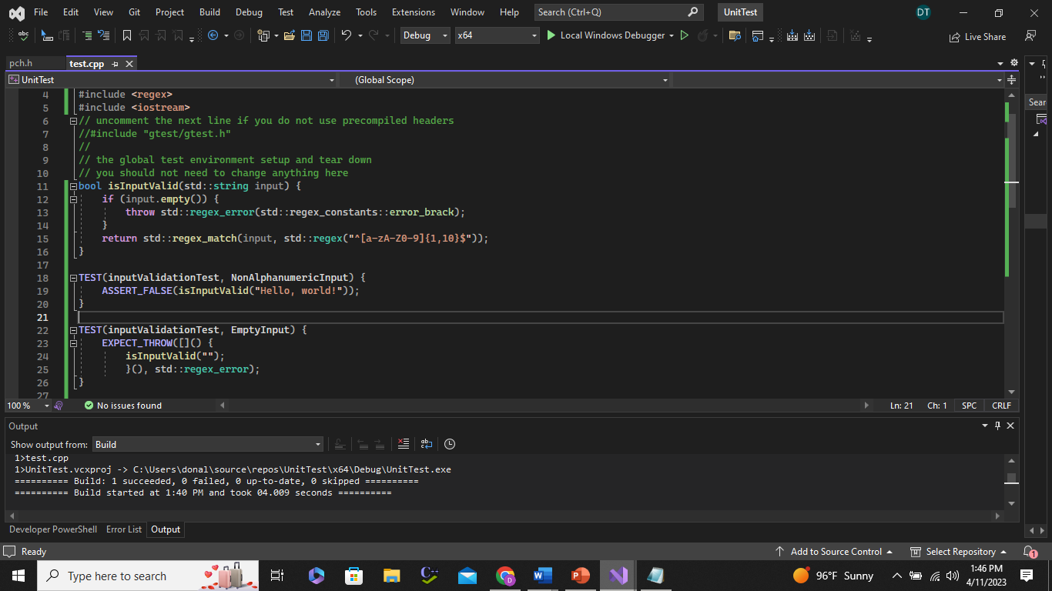
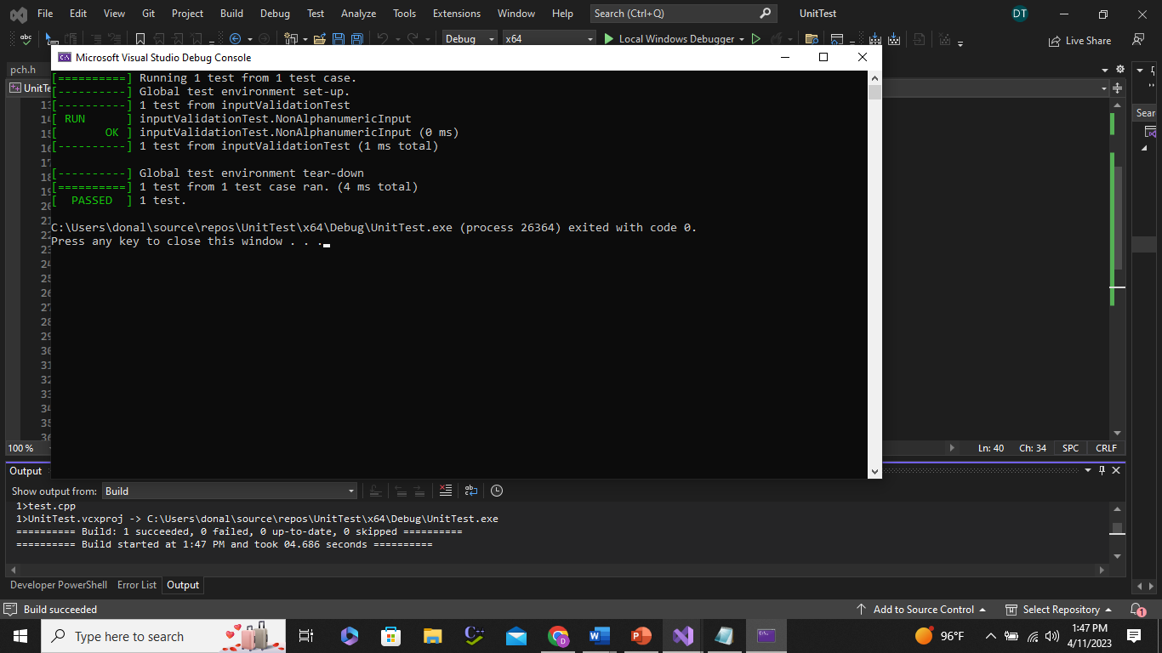
(Input Validation Test, Nonalphanumeric Input

Slide 10
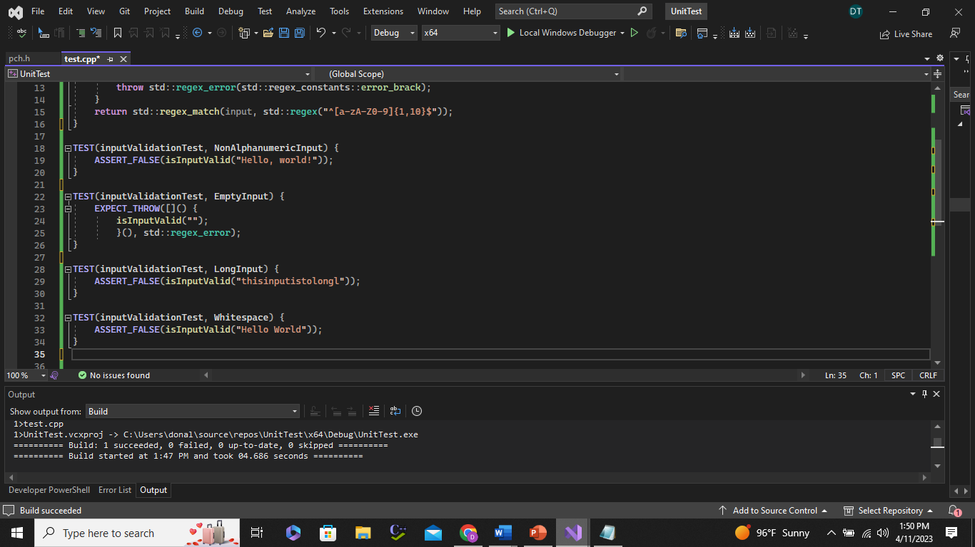
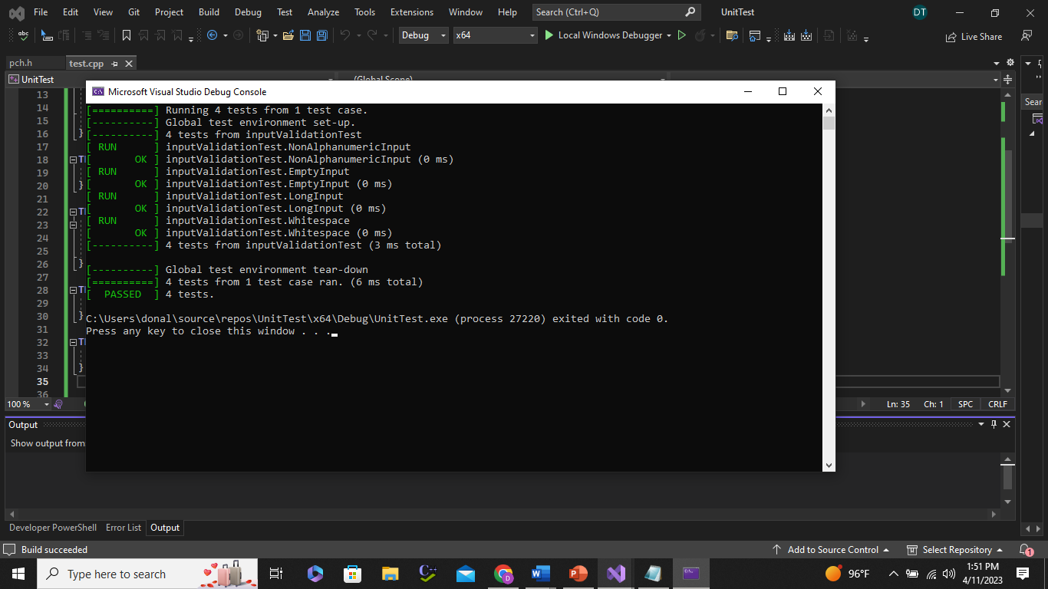
Input Validation Test, Empty Input

Slide 11
Input Validation Test, Long Input

Slide 12
Input Validation Test, Whitespace
}

Slide 13

AUTOMATION SUMMARY

Slide 14
TOOLS
DevSecOps pipeline is described as the process of integrating security into the software development life cycle. DevSecOps pipeline is a set of security practices incorporated into the Software Development Lifecycle (SDLC)to build, test, and deploy secure software faster and easier.
Access and plan stage uses agile project management tools, requirements management tools, risk management tools, collaboration tools, access management tools, and infrastructure as code (IaC)
tools.
Design stage uses UML tools to help create visual models.
Build stage uses IDE tools provide a comprehensive development environment that includes editors, compilers, debuggers, and other features that help developers write and test code more efficiently.
Test stage uses Dynamic Application Security Testing (DAST) tools, vulnerability scanners, and pen testing tools.
Transition and health check stage uses configuration Management tool, Deployment automation tools, and monitoring tools.
Monitor and detect stage uses security information and event management tools, IDPS tools, and vulnerability scanning tools.
Respond stage uses Forensic tools, Communication and Collaboration Tools, and backup and recovery tools.
Maintain and stabilize stage uses Application Performance Monitoring (APM) Tools, Log Management Tools, and Infrastructure Monitoring Tools.
Notes:
These are the tools used during the automation summary.

Slide 15
RISKS AND BENEFITS
Benefits of acting now
Improved security
Faster time to market
Increased agilty (DevSecOps practices can make it easier to respond to changing business requirements and adapt to new technology trends)
Risk of not acting now
Complexity
Lack of expertise(DevSecOps requires expertise in both development and security, which can be a challenge for organizations that lack these skills in-house.)
Cultural change (DevSecOps may require a cultural shift in the organization, which can be difficult to achieve and may take time.)
Benefits of Waiting
More time to evaluate and plan the strategy.
Reduced financial risk
Risk of Waiting
Increased risk
Lack of agility
Notes:
Risk and benefits
I will be discussing the benefits of acting now, risk of acting now, benefits of waiting and risk of waiting.

Slide 16
CONCLUSIONS
In conclusion, I believe that instituting this security policy as while as having a strong security framework, doing, regular vulnerability assessments and penetration testing, adding MFA(in policy), doing regular patching and updates, and the most important is making employee security training mandatory.

Slide 17
REFERENCES
Anon
(2023). Retrieved 11 April 2023, from https://www.auditboard.com/blog/what-is-a-risk-assessment-matrix/
DevSecOps Pipeline Overview: DevSecOps Simplified | Perforce Software. (2023). Retrieved 13 April 2023, from https://www.perforce.com/blog/kw/devsecops-pipeline-overview

